Slide 1
PROGRAMMING IN PYTHON
PYTHON FUNCTION
Mrs. C.SHYAMALADEVI M.C.A., M.Phil., B.Ed.,
ASSISTANT PROFESSOR,
DEPARTMENT OF COMPUTER SCIENCE,
SHRIMATI INDIRA GANDHI COLLEGE,
TRICHY-2.

Slide 2

•Understand the concept of function and their types.
• Know the difference between User defined and Built in functions.
• Know how to call a function.
•Understand the function arguments.
• Know Anonymous functions.
•Know Mathematical and some String functions.

Slide 3
Functions are named blocks of code that are designed to do specific job.
When you want to perform a particular task that you have defined in a function, you call the name of the function responsible for it.
If you need to perform that task multiple times throughout your program, you don’t need to type all the code for the same task again and again; you just call the function dedicated to handling that task, and the call tells Python to run the code inside the function.
You’ll find that using functions makes your programs easier to write, read, test, and fix errors.

Slide 4
Advantages of functions are
• It avoids repetition and makes high degree of code reusing.
• It provides better modularity for your application.

Slide 5
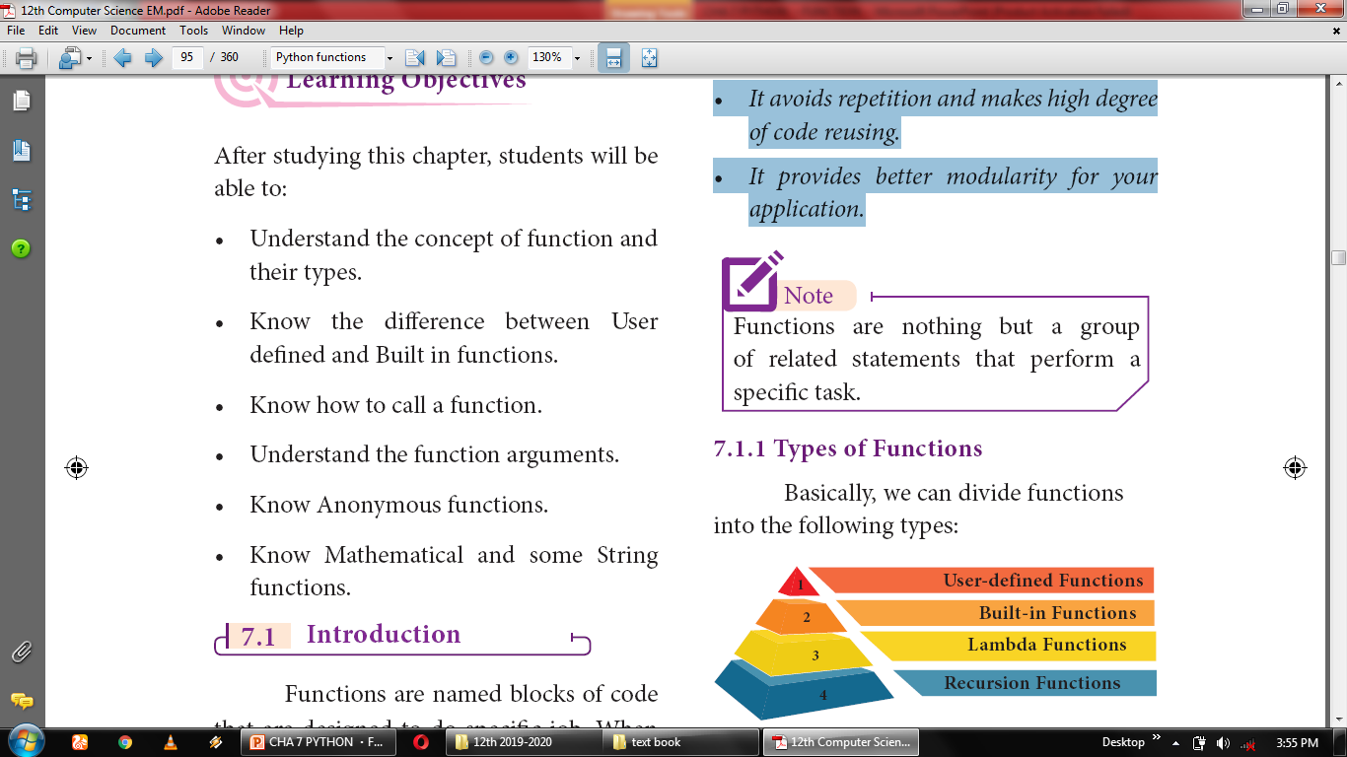

Slide 6
Types of Functions

Slide 7
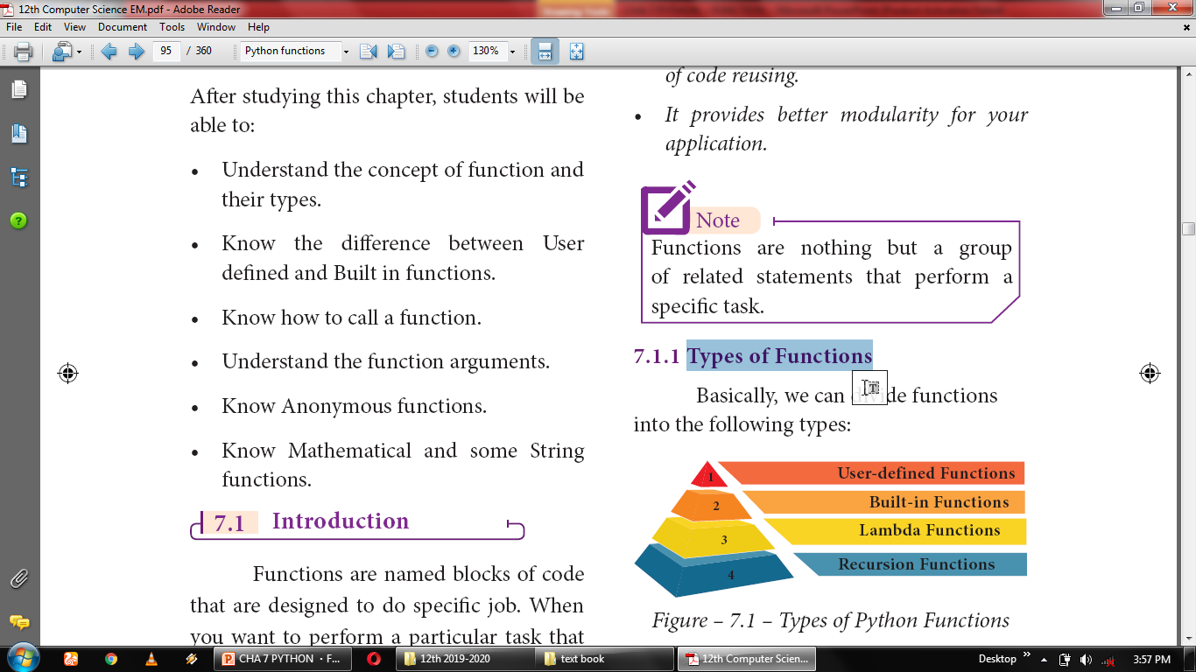

Slide 8
Functions | Description
User-defined functions | Functions defined by the users themselves.
Built-in functions | Functions that are inbuilt with in Python.
Lambda functions | Functions that are anonymous un-named function.
Recursion functions | Functions that calls itself is known as recursive

Slide 9
Defining Functions

Slide 10
Functions must be defined, to create and use certain functionality.
There are many built-in functions that comes with the language python (for instance, the print() function), but you can also define your own function.
When defining functions there are multiple things that need to be noted;

Slide 11
Function blocks begin with the keyword “def” followed by function name and parenthesis ().
Any input parameters or arguments should be placed within these parentheses when you define a function.
The code block always comes after a colon (:) and is indented.
The statement “return [expression]” exits a function, optionally passing back an expression to the caller. A “return” with no arguments is the same as return None.

Slide 12
syntax
def <function_name ([parameter1, parameter2…] )> :
<Block of Statements>
return <expression / None>

Slide 13
Block
A block is one or more lines of code, grouped together so that they are treated as one big sequence of statements while execution.
In Python, statements in a block are written with indentation.
Usually, a block begins when a line is indented (by four spaces) and all the statements of the block should be at same indent level.

Slide 14
Nested block
A block within a block is called nested block.
When the first block statement is indented by a single tab space, the second block of statement is indented by double tab spaces.

Slide 15
EXAMPLE
def hello():
print (“SIGC”)
return
hello()
OUTPUT:
SIGC

Slide 16
EXAMPLE
def my_function(): print("Hello from a function")
my_function()
OUTPUT:
Hello from a function

Slide 17
Advantages of User-defined Functions
Functions help us to divide a program into modules. This makes the code easier to manage.
2. It implements code reuse. Every time you need to execute a sequence of statements, all you need to do is to call the function.
3. Functions, allows us to change functionality easily, and different programmers can work on different functions.

Slide 18
Calling function
EXAMPLE
def printinfo( name, salary = 3500):
print ("Name: ", name)
print ("Salary: ", salary)
return
printinfo(“Anupriya”)
OUTPUT:
Name: Anupriya
Salary: 3500

Slide 19
EXAMPLE
def hello():
print ("hello - Python")
return
print (hello())
OUTPUT:
hello - Python
None

Slide 20
Passing Parameters in Functions

Slide 21
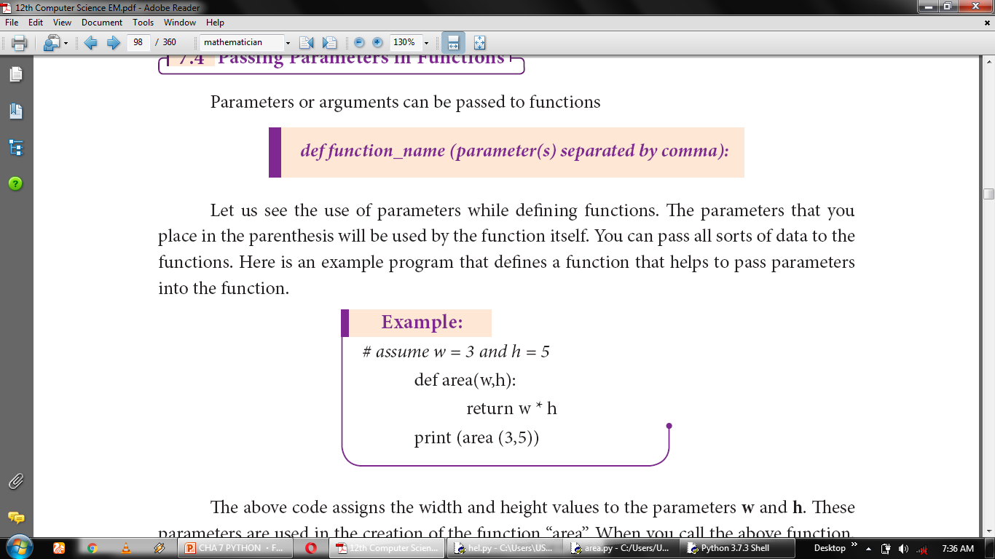

Slide 22
The parameters that you place in the parenthesis will be used by the function itself. You can pass all sorts of data to the functions.

Slide 23
EXAMPLE
# assume w = 3 and h = 5
def area(w,h):
return w * h
print (area (3,5))
OUTPUT:
15

Slide 24
The above code assigns the width and height values to the parameters w and h.
These parameters are used in the creation of the function “area”. When you call the above function, it returns the product of width and height as output.
The value of 3 and 5 are passed to w and h respectively, the function will return 15 as output.

Slide 25
EXAMPLE
def my_function(x):
return 5 * x
print(my_function(3))
print(my_function(5))
print(my_function(9))
OUTPUT:
15
25
45

Slide 26
Parameters | Arguments
The variables used in the function definition | The values we pass to the function parameters

Slide 27
Function Arguments

Slide 28
Arguments are used to call a function and there are primarily 4 types of functions that one can use:
Required arguments
Keyword arguments
Default arguments
Variable-length arguments

Slide 29
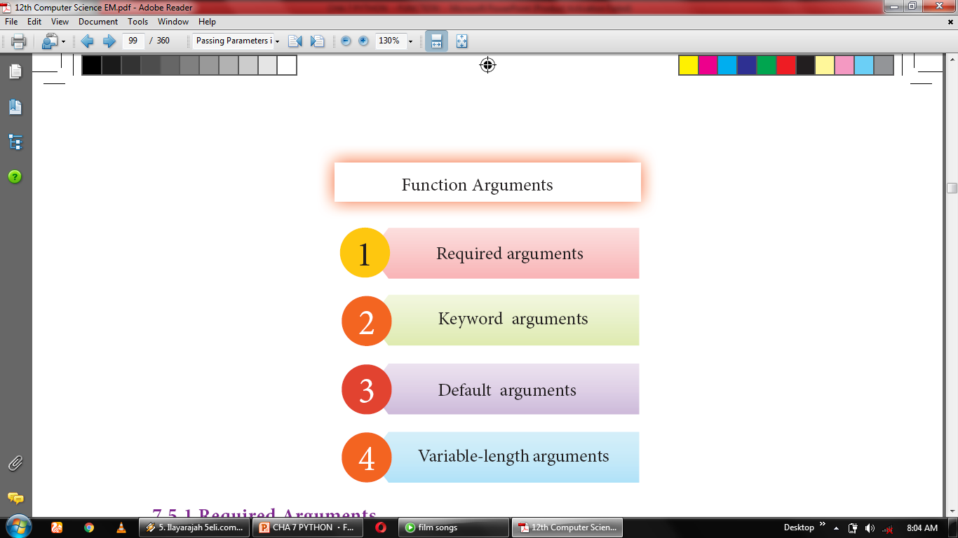

Slide 30
Required Arguments

Slide 31
“Required Arguments” are the arguments passed to a function in correct positional order.
Here, the number of arguments in the function call should match exactly with the function definition.
You need at least one parameter to prevent syntax errors to get the required output.

Slide 32
Wrong code
def printstring(str):
print ("Example - Required arguments ")
print(str)
return
printstring()

Slide 33
Correct code
def printstring(str):
print ("Example - Required arguments ")
print(str)
return
printstring(“Welcome")
Output:
Example - Required arguments
Welcome

Slide 34
Keyword Arguments

Slide 35
Keyword arguments will invoke the function after the parameters are recognized by their parameter names.
The value of the keyword argument is matched with the parameter name and so, one can also put arguments in improper order (not in order).

Slide 36
Correct code
def printdata (name):
print ("Example-2 Keyword arguments")
print ("Name :",name)
return
# Now you can call printdata() function
printdata (name = “Anupriya”)
Output:
Example-2 Keyword arguments
Name :Anupriya

Slide 37
Wrong code
def printdata (name):
print (“Example-2 Keyword arguments”)
print (“Name :”, name)
return
# Now you can call printdata() function
printdata (name1 = “Gshan”)
TypeError: printdata() got an unexpected keyword argument 'name1'

Slide 38
Correct code
def printdata (name, age):
print ("Example-3 Keyword arguments")
print ("Name :",name)
print ("Age :",age)
return
# Now you can call printdata() function
printdata (age=25, name=" Anupriya ")
Output:
Example-3 Keyword arguments
Name : Anupriya
Age : 25

Slide 39
Default Arguments

Slide 40
In Python the default argument is an argument that takes a default value if no value is provided in the function call.

Slide 41
EXAMPLE
def printinfo( name, salary = 3500):
print ("Name: ", name)
print ("Salary: ", salary)
return
printinfo(" Anupriya ")
Output:
Name: Anupriya
Salary: 3500

Slide 42
EXAMPLE
def printinfo( name, salary = 3500):
print ("Name: ", name)
print ("Salary: ", salary)
return
printinfo(“Anupriya ",2000)
Output:
Name: Anupriya
Salary: 2000

Slide 43
Variable-Length Arguments

Slide 44
EXAMPLE
def sum(x,y,z):
print("sum of three nos :",x+y+z)
sum(5,10,15)
OUTPUT:
sum of three nos : 30

Slide 45
Syntax
def function_name(*args):
function_body
return_statement

Slide 46
Python has *args which allow us to pass the variable number of non keyword arguments to function.

Slide 47
EXAMPLE
def adder(*num):
sum = 0
for n in num:
sum = sum + n
print("Sum:",sum)
adder(3,5)
adder(4,5,6,7)
adder(1,2,3,5,6)
Output:
8
22
17

Slide 48
EXAMPLE: def printnos (*nos): for n in nos: print(n) return # now invoking the printnos() function print ("Printing two values") printnos (1,2) print ('Printing three values') printnos (10,20,30)

Slide 49
OUTPUT: Printing two values 1 2 Printing three values 10 20 30

Slide 50
EXAMPLE
def printnames (*names):
for n in names:
print(n)
return
# now invoking the printnos() function
print ("Printing four names")
printnames (‘ABC’,’DEF’, ‘GHI’,’JKL’)
print ('Printing three names')
printnames (‘MNO’,’PQR’, ‘STU’)

Slide 51
OUTPUT: Printing four names ABC DEF GHI JKL Printing three names MNO PQR STU

Slide 52
In Variable Length arguments we can pass the arguments using two methods.
1. Non keyword variable arguments
2. Keyword variable arguments

Slide 53
Non-keyword variable arguments are called tuples.

Slide 54
Anonymous Functions

Slide 55
In Python, anonymous function is a function that is defined without a name.
While normal functions are defined using the def keyword, in Python anonymous functions are defined using the lambda keyword.
Hence, anonymous functions are also called as lambda functions.

Slide 56
What is the use of lambda or anonymous function?
Lambda function is mostly used for creating small and one-time anonymous function.
Lambda functions are mainly used in combination with the functions like filter(), map() and reduce().

Slide 57
Syntax
lambda [argument(s)] :expression

Slide 58
EXAMPLE
sum = lambda arg1, arg2: arg1 + arg2
print ('The Sum is :', sum(30,40))
print ('The Sum is :', sum(-30,40))
Output:
The Sum is : 70
The Sum is : 10

Slide 59
EXAMPLE
x = lambda a : a + 10
print(x(5))
Output:
15

Slide 60
EXAMPLE
x = lambda a, b : a * b
print(x(5, 6))
Output:
30

Slide 61
EXAMPLE
x = lambda a, b, c : a + b + c
print(x(5, 6, 2))
Output:
13

Slide 62
The return Statement

Slide 63
The return statement causes your function to exit and returns a value to its caller. The point of functions in general is to take inputs and return something.
The return statement is used when a function is ready to return a value to its caller. So, only one return statement is executed at run time even though the function contains multiple return statements.
Any number of 'return' statements are allowed in a function definition but only one of them is executed at run time.

Slide 64
Syntax
return [expression list ]

Slide 65
This statement can contain expression which gets evaluated and the value is returned. If there is no expression in the statement or the return statement itself is not present inside a function, then the function will return the None object.

Slide 66
EXAMPLE
def usr_abs (n):
if n>=0:
return n
else:
return -n
x=int (input("Enter a number :"))
print(usr_abs (x))
Output 1:
Enter a number : 25
25
Output 2:
Enter a number : -25
25

Slide 67
Scope of Variables

Slide 68
Scope of variable refers to the part of the program, where it is accessible, i.e., area where you can refer (use) it. We can say that scope holds the current set of variables and their values. Two types of scopes :
LOCAL SCOPE
GLOBAL SCOPE

Slide 69
Local Scope
A variable declared inside the function's body or in the local scope is known as local variable.
Rules of local variable
A variable with local scope can be accessed only within the function/block that it is created in.
When a variable is created inside the function/block, the variable becomes local to it.
A local variable only exists while the function is executing.
The format arguments are also local to function.

Slide 70
EXAMPLE
def loc():
y=5 # local scope
print(y)
loc()
Output:
5

Slide 71
Global Scope
A variable, with global scope can be used anywhere in the program. It can be created by defining a variable outside the scope of any function/block.
Rules of global Keyword
The basic rules for global keyword in Python are:
When we define a variable outside a function, it’s global by default. You don’t have to use global keyword.
We use global keyword to read and write a global variable inside a function.
Use of global keyword outside a function has no effect

Slide 72
EXAMPLE
c = 1 # global variable
def add():
print(c)
add()
Output:
1

Slide 73
EXAMPLE
x = 0 # global variable
def add():
global x
x = x + 5 # increment by 2
print ("Inside add() function x value is :", x)
add()
print ("In main x value is :", x)
Output:
Inside add() function x value is : 5
In main x value is : 5

Slide 74
Global and local variables

Slide 75
EXAMPLE
Using Global and Local variables in same code
x=8 # x is a global variable
def loc():
global x
y = "local"
x = x * 2
print(x)
print(y)
loc()
OUTPUT:
16
local

Slide 76
EXAMPLE
Global variable and Local variable with same name
x= 5
def loc():
x = 10
print ("local x:", x)
loc()
print ("global x:", x)
OUTPUT:
local x: 5
global x: 5

Slide 77
Functions using libraries

Slide 78
Built-in and Mathematical functions

Slide 79
abs ( )

Slide 80
Returns an absolute value of a number.
The argument may be an integer or a floating point number.

Slide 81
Syntax
abs(x)

Slide 82
EXAMPLE
x=20
y=-23.2
print('x = ', abs(x))
print('y = ', abs(y))
Output:
x = 20
y = 23.2

Slide 83
ord( )

Slide 84
Returns the ASCII value for the given Unicode character.
This function is inverse of chr() function.

Slide 85
Syntax
ord(c)

Slide 86
EXAMPLE
c= 'a'
d= 'A'
print ('c = ',ord (c))
print ('A = ',ord (d))
Output:
c = 97
A = 65

Slide 87
chr( )

Slide 88
Returns the Unicode character for the given ASCII value.
This function is inverse of ord() function.

Slide 89
Syntax
chr(i)

Slide 90
EXAMPLE
c=65
d=43
print (chr (c))
print(chr (d))
Output:
A
+

Slide 91
bin( )

Slide 92
Returns a binary string prefixed with “0b” for the given integer number.
Note: format () can also be used instead of this function.

Slide 93
Syntax
bin(i)

Slide 94
EXAMPLE
x=15
y=101
print ('15 in binary : ',bin (x))
print ('101 in binary : ',bin (y))
Output:
15 in binary : 0b1111
101 in binary : 0b1100101

Slide 95
type( )

Slide 96
Returns the type of object for the given single object.
Note: This function used with single object parameter.

Slide 97
Syntax
type(object)

Slide 98
EXAMPLE
x= 15.2
y= 'abc'
s= True
d=23
print (type (x))
print (type (y))
print (type (s))
print (type (d))
Output:
<class 'float'>
<class 'str'>
<class 'bool’>
<class 'int'>

Slide 99
id( )

Slide 100
Syntax
id(object)

Slide 101
id( ) Return the “identity” of an object. i.e. the address of the object in memory.
Note: the address of x and y may differ in your system

Slide 102
EXAMPLE
x=1566
y='a'
print ('address of x is :',id (x))
print ('address of y is :',id (y))
Output:
address of x is : 1944879179632
address of y is : 1944844788080

Slide 103
min( )

Slide 104
Syntax
min(list)

Slide 105
Returns the minimum value in a list

Slide 106
EXAMPLE
MyList = [21,76,98,23]
print ('Minimum of MyList :', min(MyList))
Output:
Minimum of MyList : 21

Slide 107
max( )

Slide 108
Syntax
max(list)

Slide 109
Returns the maximum value in a list

Slide 110
EXAMPLE
MyList = [21,76,98,23]
print ('Maximum of MyList :', max(MyList))
Output:
Maximum of MyList : 98

Slide 111
sum( )

Slide 112
Syntax
sum(list)

Slide 113
Returns the sum of values in a list

Slide 114
EXAMPLE
MyList = [21,76,98,23]
print ('Sum of MyList :', sum(MyList))
Output:
Sum of MyList : 218

Slide 115
format( )

Slide 116
Syntax
format(value [, format_spec])

Slide 117
Returns the output based on the given format
1. Binary format. Outputs the number in base 2.
2. Octal format. Outputs the number in base 8.
3.Fixed-point notation. Displays the number as a fixed-point number. The default precision is 6.

Slide 118
EXAMPLE
x= 14
y= 25
print ('x value in binary :',format(x,'b'))
print ('y value in octal :',format(y,'o'))
print('y value in Fixed-point no ',format(y,'f'))
Output:
x value in binary : 1110
y value in octal : 31
y value in Fixed-point no : 25.000000

Slide 119
round( )

Slide 120
Syntax
round(number [,ndigits])

Slide 121
Returns the nearest integer to its input.
1. First argument (number) is used to specify the value to be rounded.
2. Second argument (ndigits) is used to specify the number of decimal digits desired after rounding.

Slide 122
EXAMPLE
x= 17.9
y= 22.2
z= -18.3
print ('x value is rounded to', round (x))
print ('y value is rounded to', round (y))
print ('z value is rounded to', round (z))
Output:1
x value is rounded to 18
y value is rounded to 22
z value is rounded to -18

Slide 123
pow( )

Slide 124
Syntax
pow(a,b)

Slide 125
Returns the computation of ab
i.e. (a**b ) a raised to the power of b.

Slide 126
EXAMPLE
a= 5
b= 2
c= 3.0
print (pow (a,b))
print (pow (a,c))
print (pow (a+b,3))
Output:
25
125.0
343

Slide 127
Mathematical Functions

Slide 128
floor( )

Slide 129
Syntax
math.floor(x)

Slide 130
Returns the largest integer less than or equal to x

Slide 131
EXAMPLE
import math
x=26.7
y=-26.7
z=-23.2
print (math.floor (x))
print (math.floor (y))
print (math.floor (z))
Output:
26
-27
-24

Slide 132
ceil( )

Slide 133
Syntax
math.ceil(x)

Slide 134
Returns the smallest integer greater than or equal to x

Slide 135
EXAMPLE
import math
x= 26.7
y= -26.7
z= -23.2
print (math.ceil (x))
print (math.ceil (y))
print (math.ceil (z))
Output:
27
-26
-23

Slide 136
sqrt( )

Slide 137
Syntax
sqrt(x)

Slide 138
Returns the square root of x
Note: x must be greater than 0 (zero)

Slide 139
EXAMPLE
import math
a= 30
b= 49
c= 25.5
print (math.sqrt (a))
print (math.sqrt (b))
print (math.sqrt (c))
Output:
5.477225575051661
7.0
5.049752469181039

Slide 140
Composition in functions
What is Composition in functions?

Slide 141
The value returned by a function may be used as an argument for another function in a nested manner. This is called composition.

Slide 142
if we wish to take a numeric value or an expression as a input from the user, we take the input string from the user using the function
input() and eval() function to evaluate its value

Slide 143
Python Recursive Functions

Slide 144
When a function calls itself is known as recursion
A recursive function calls itself.

Slide 145
EXAMPLE
def fact(n):
if n == 0:
return 1
else:
return n * fact (n-1)
print (fact (0))
print (fact (5))
OUTPUT:
1
120

Slide 146
Overview of how recursive function works
1. Recursive function is called by some external code.
2. If the base condition is met then the program gives meaningful output and exits.
3. Otherwise, function does some required processing and then calls itself to continue recursion.

Slide 147
Thank you

